Slide 1
Adminstered by
Learn
ShareWELLhealth.org

Slide 2
What is healthcare freedom?
It means being able to make your own healthcare choices without them being dictated by a network or other restrictions. The traditional system is not designed to allow for choice, and ShareWELL allows members to seek care on their terms from their choice of clinician.
Need To Know
?
What is ShareWELL
Is ShareWELL the right fit
Savings
Advantages
Moving Forward
?
?
?
?

Slide 3
What is ShareWELL
Although the concept is new to many, Health Sharing is a proven concept that has worked for millions of Americans for 40+ years.
What It Does
How it Does It
Cuts healthcare spending by 40-60%
Gives the freedom to choose any provider.
Lowers overall spending on healthcare for the entire community to equal savings for all.
Provides healthcare tools for wherever a healthcare journey may lead.
With a lower monthly cost and lower out-of-pocket spending
Members navigate healthcare as self-pay patients without a network.
Leverages self-pay, advocacy, and negotiations while passing on the savings.
By providing easy access to an advocacy team, members have what they need when needed.
Did you know?
The average monthly cost for health insurance is $745 for an individual and $2,131 for a family according to Kff.org

Slide 4
Right Fit?
Determine who in your community will be able to get the most of out of a ShareWELL membership
50%
50%
A Good Fit
Not A Good Fit
For those in good health who are paying the full cost of health insurance on their own, looking for protection against unexpected medical expenses rather than high premiums for routine care.
Not ideal for those with serious health (Pre-X) conditions requiring frequent care, or for those whose healthcare costs are covered by an employer or government program

Slide 5
Ensuring The Right Fit.
By helping people understand how ShareWELL can save them money and its limitations, you’ll ensure the right individuals join our community and experience more affordable healthcare.
ShareWELL has limitations for pre-existing conditions and those already pregnant. By having these limitations in place, we can provide a more affordable approach for the right people.

Slide 6
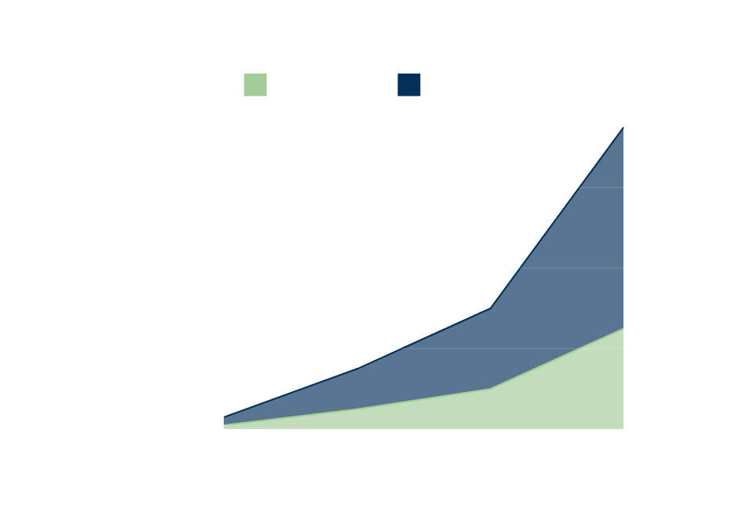
Annual Healthcare Spending
Annual Healthcare Spending
Individual, Couples & Families
Company’s by Number of Employees

Slide 7
Advantages
Did you know? Many people with conventional plans pay the full cost of holistic care and often can afford it due to high monthly premiums.
Examples of communities where ShareWELL can be the right fit.
Self Employed
Holistic and Healthy Minded
Freedom to see any provider without network restrictions including internationally
ShareWELL members can use clinicians from holistic minded backgrounds including functional, homeopathic, naturopathic, and more!
Avoid managing subsidies and the hurdles of an unpredictable income
Preventive services can be included, to expand on the types of preventive service that can be shared with the community.
Less out-of-pocket expenses compared to high deductibles when the unexpected in life happens
ShareWELL members save on their healthcare spending, allowing them more flexibility to spend other aspects of their health and well-being.

Slide 8
Moving Forward
Freedom & Savings
ShareWELL | Conventional Plans | Impact of Switching
Lower Monthly Contribution | High Premiums | Annual savings of $3,000+ per person
No Networks | HMO, PPO, POS Provider networks | Easier access to more doctors
$1,500, $3,000, $6,000 Unshared Amount | High Deductibles, Copays, Coinsurance, Out of Pocket Maximums | Spending less on unexpected healthcare
Community | Insurance Company | Member Centric
Non Profit | Wallstreet | Funds being used towards community members
Did you know?
The new maximum deductible for health coverage in 2025 is $9,200 for an individual and $18,400 for a family.

Slide 9
Advocacy Can Help
Have your member call, chat, submit a ticket or email for quick responses.

Slide 10
Resource
As an affiliate you will be provided with resources and support to help you positively impact your community.
Simple Next Day Enrollment
Affiliate Tracking Link
Weekly Training
Affiliate Resources Page

